Slide 1
Autoencoders
What they do, how they work and why they are cool…
(lots of code at http://adl.toelt.ai/)

Slide 3
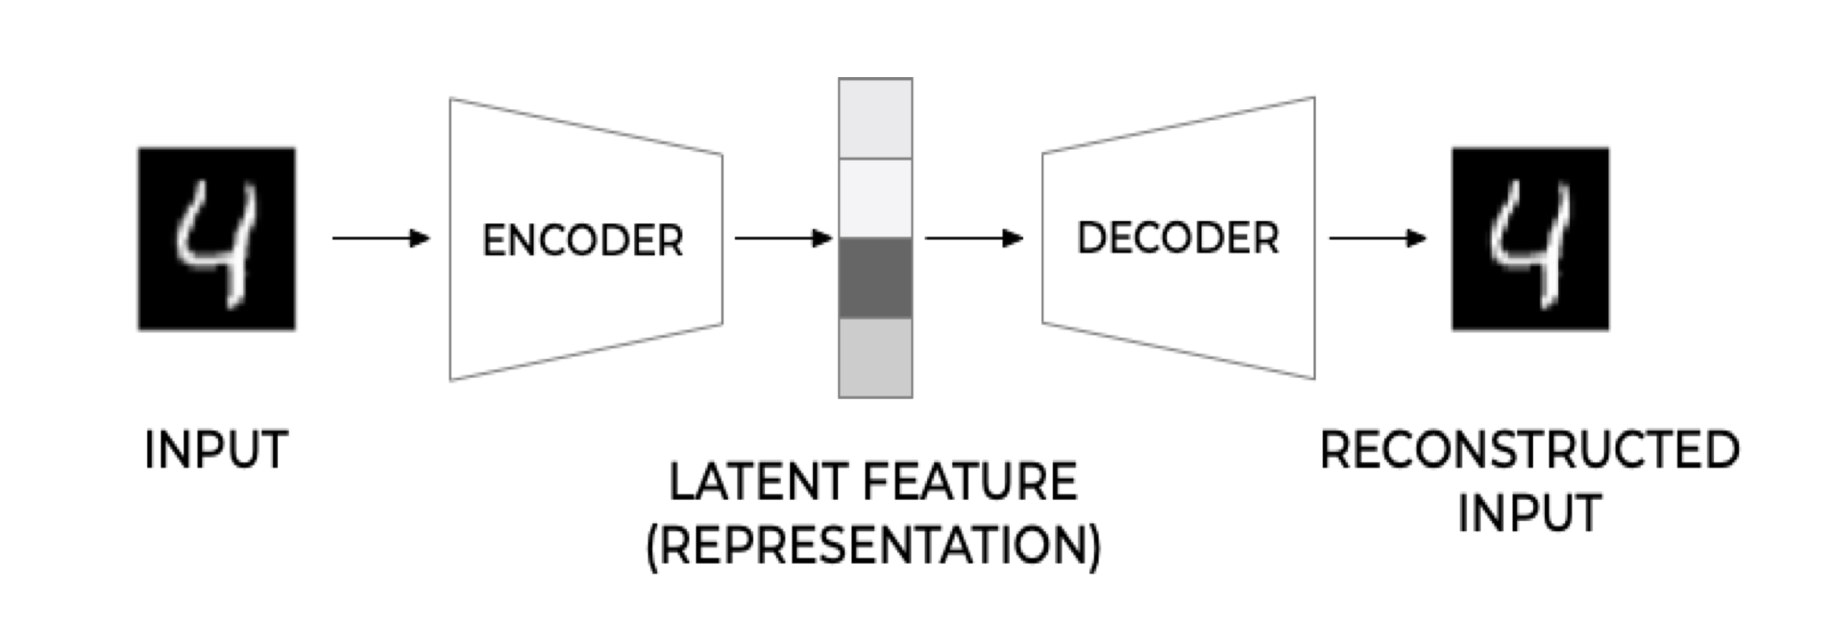
General Structure
Michelucci, Umberto. "An Introduction to Autoencoders." arXiv preprint arXiv:2201.03898 (2022).

Slide 4
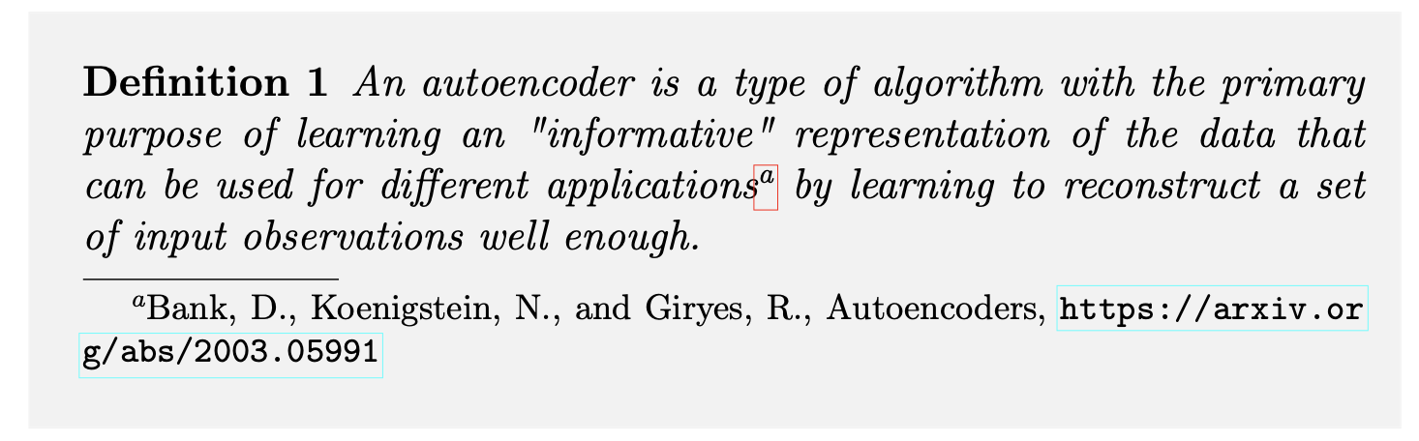
Definition
Michelucci, Umberto. "An Introduction to Autoencoders." arXiv preprint arXiv:2201.03898 (2022).

Slide 5
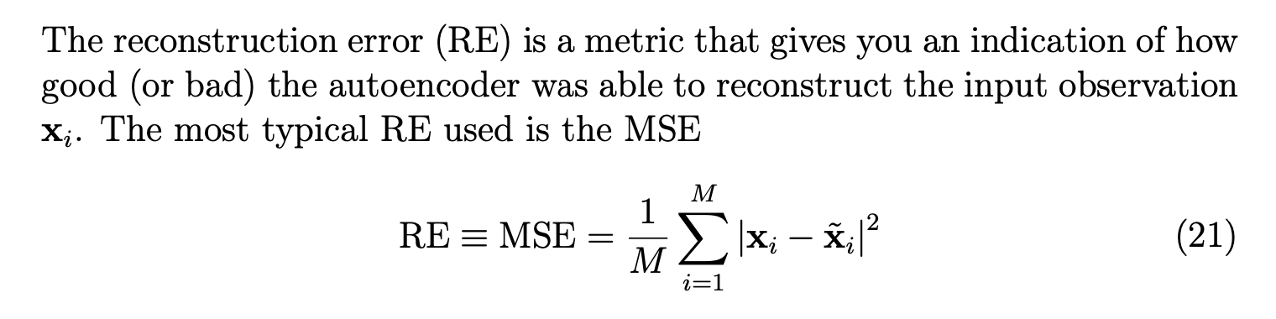
Reconstruction Error
Michelucci, Umberto. "An Introduction to Autoencoders." arXiv preprint arXiv:2201.03898 (2022).

Slide 6
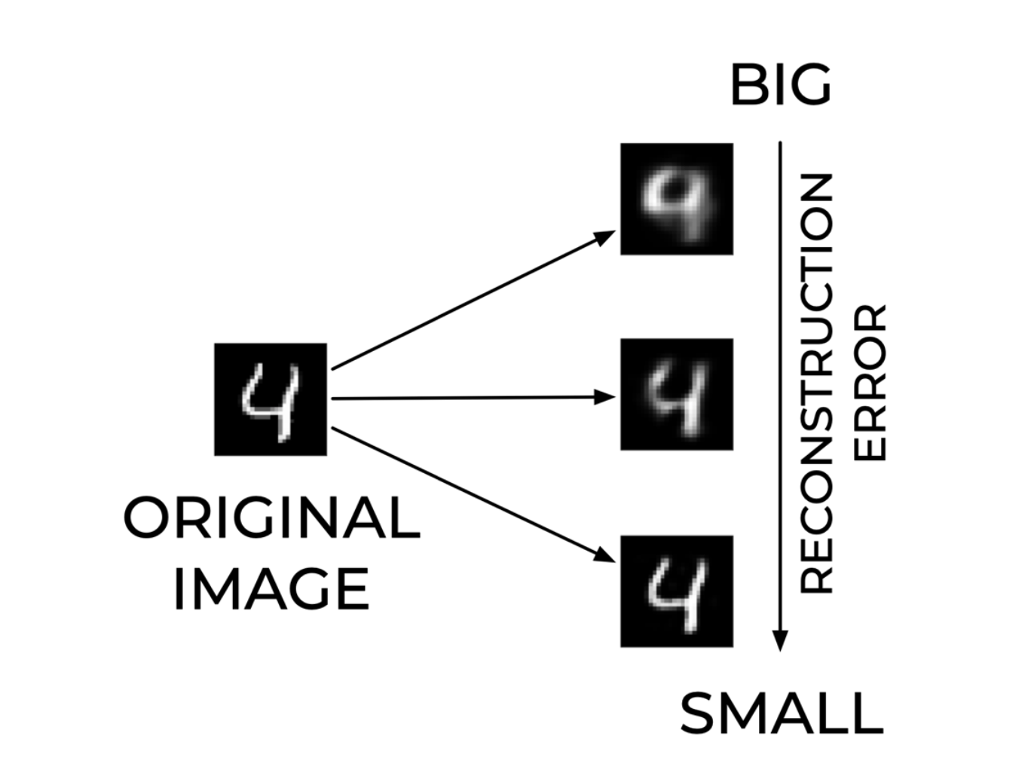
Reconstruction Error – An Example
Michelucci, Umberto. "An Introduction to Autoencoders." arXiv preprint arXiv:2201.03898 (2022).

Slide 7
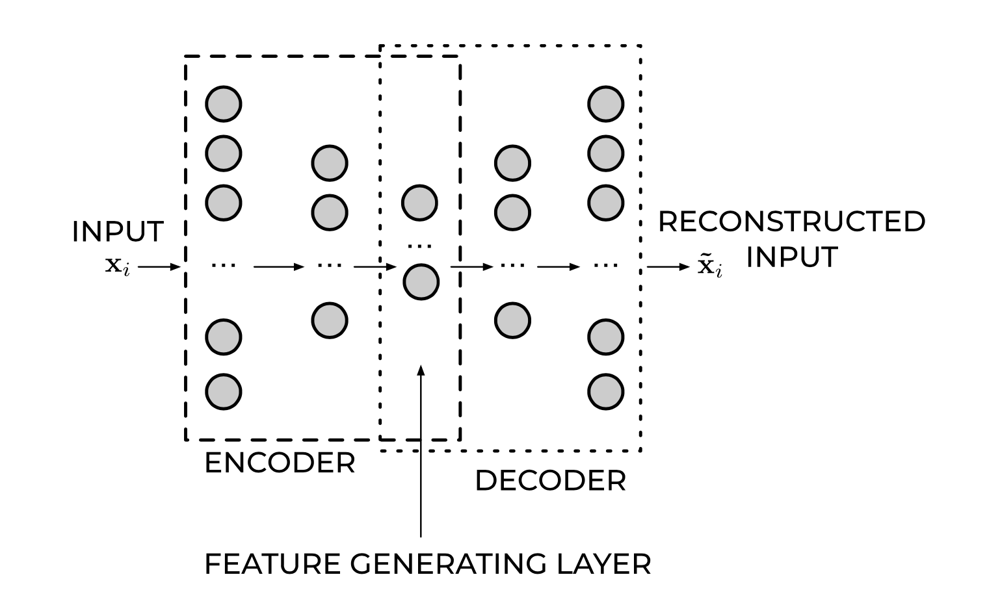
Feed Forward Autoencoders
Michelucci, Umberto. "An Introduction to Autoencoders." arXiv preprint arXiv:2201.03898 (2022).

Slide 8
Smaller autoencoders and results

Slide 9
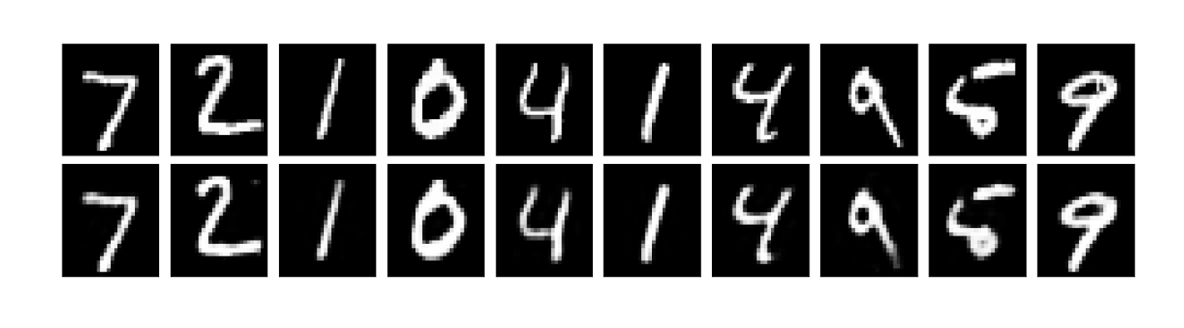
Examples (784,64,784)
Michelucci, Umberto. "An Introduction to Autoencoders." arXiv preprint arXiv:2201.03898 (2022).

Slide 10
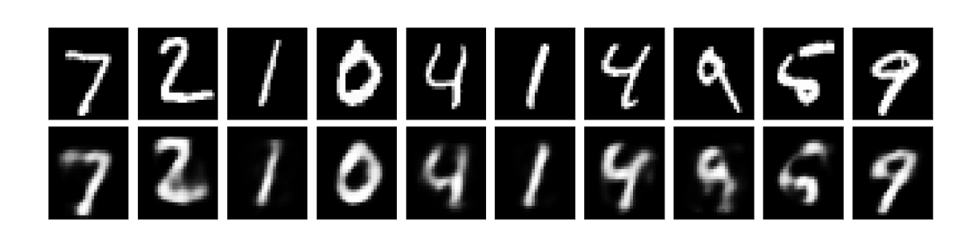
Examples (784,16,784)
Michelucci, Umberto. "An Introduction to Autoencoders." arXiv preprint arXiv:2201.03898 (2022).

Slide 11
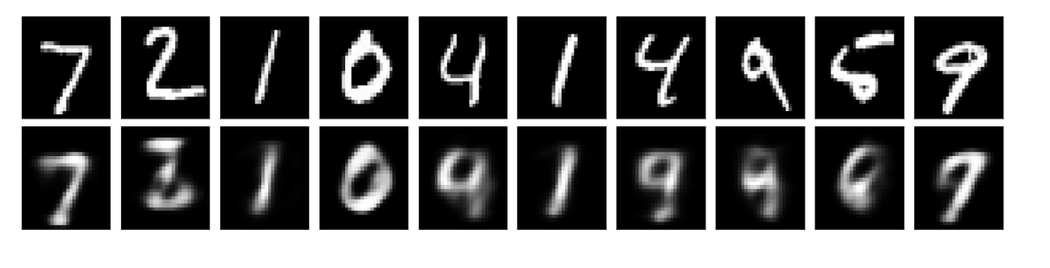
Examples (784,8,784)
Michelucci, Umberto. "An Introduction to Autoencoders." arXiv preprint arXiv:2201.03898 (2022).

Slide 12
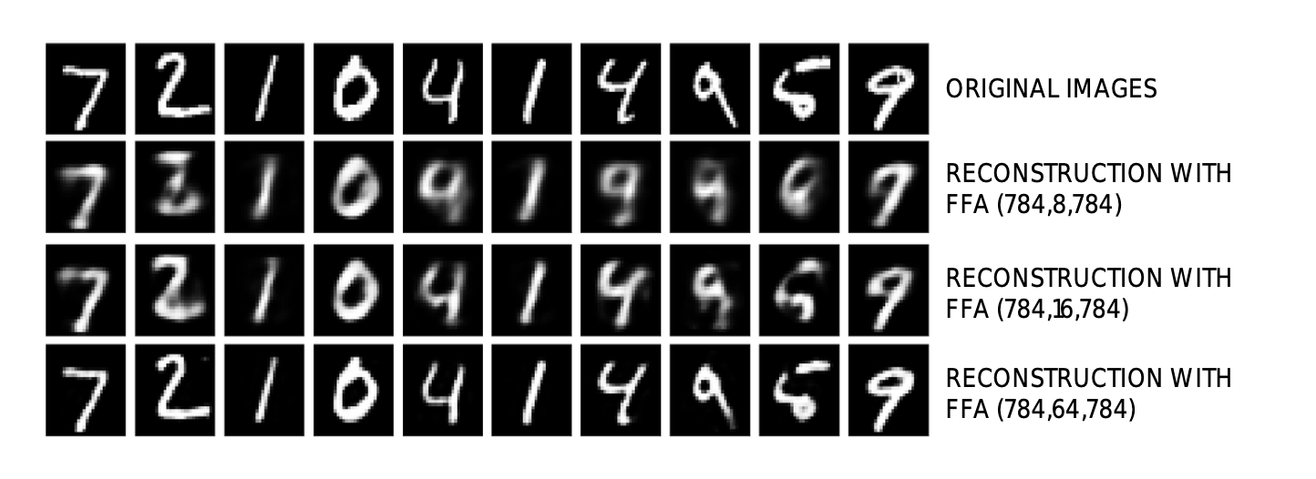
Examples (784,8,784)
Michelucci, Umberto. "An Introduction to Autoencoders." arXiv preprint arXiv:2201.03898 (2022).

Slide 13
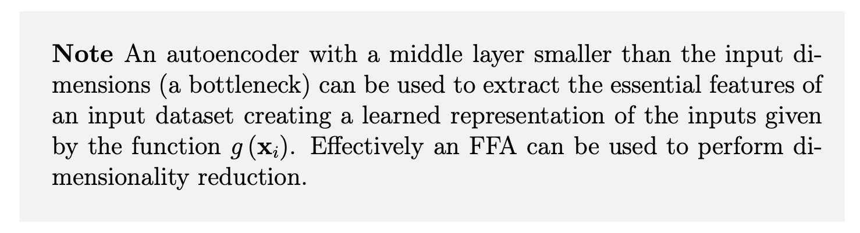
Dimensionality Reduction
Michelucci, Umberto. "An Introduction to Autoencoders." arXiv preprint arXiv:2201.03898 (2022).

Slide 15
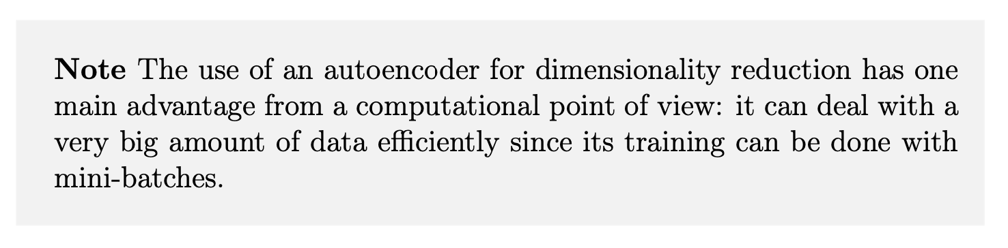
Dimensionality Reduction - Advantages
Michelucci, Umberto. "An Introduction to Autoencoders." arXiv preprint arXiv:2201.03898 (2022).

Slide 16
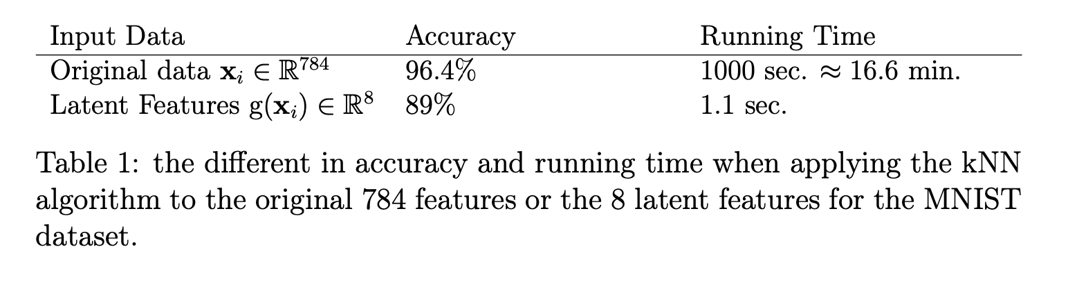
Latent Features for classification (kNN with k=7)
Michelucci, Umberto. "An Introduction to Autoencoders." arXiv preprint arXiv:2201.03898 (2022).

Slide 17
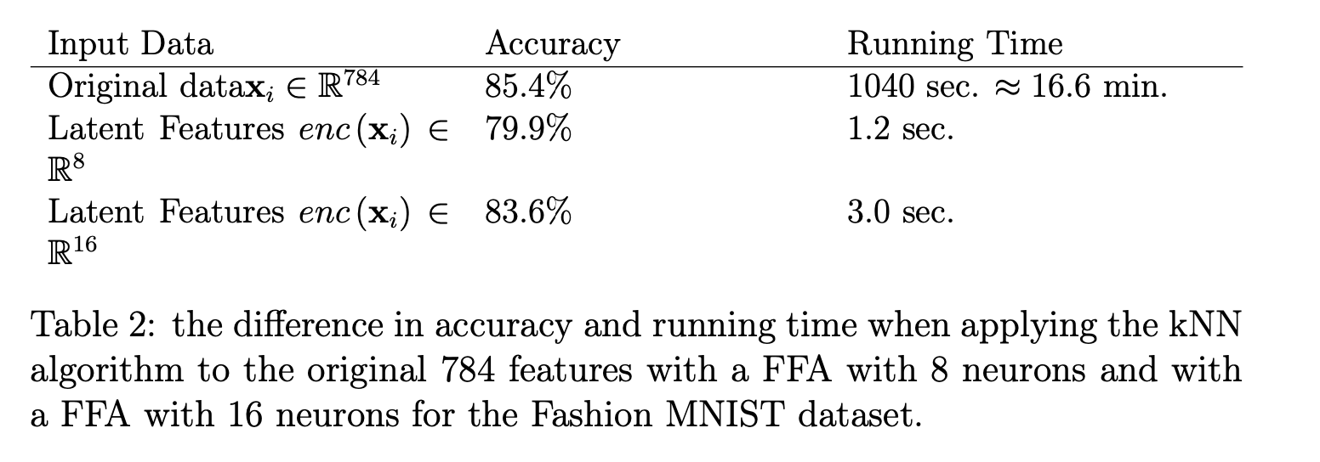
Latent Features for classification (kNN with k=7)
Michelucci, Umberto. "An Introduction to Autoencoders." arXiv preprint arXiv:2201.03898 (2022).

Slide 18
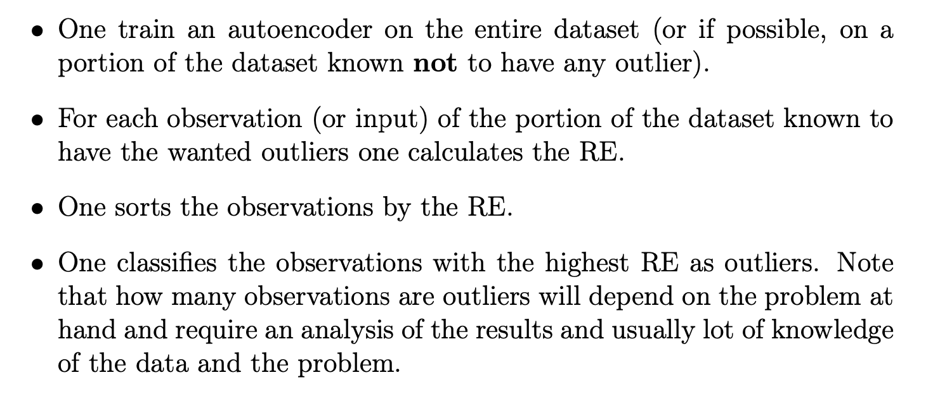
Anomaly Detection - Steps
Michelucci, Umberto. "An Introduction to Autoencoders." arXiv preprint arXiv:2201.03898 (2022).

Slide 19
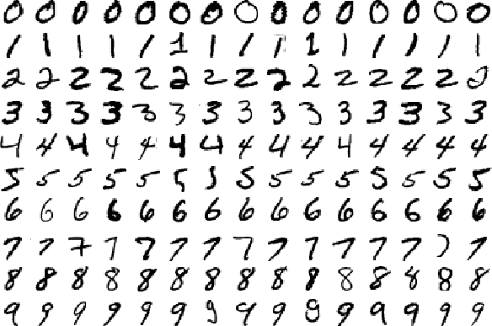
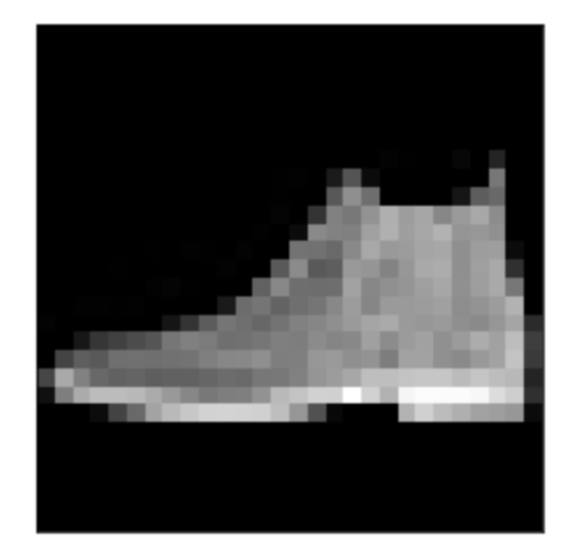
Anomaly Detection
The Dataset
The anomaly

Slide 20
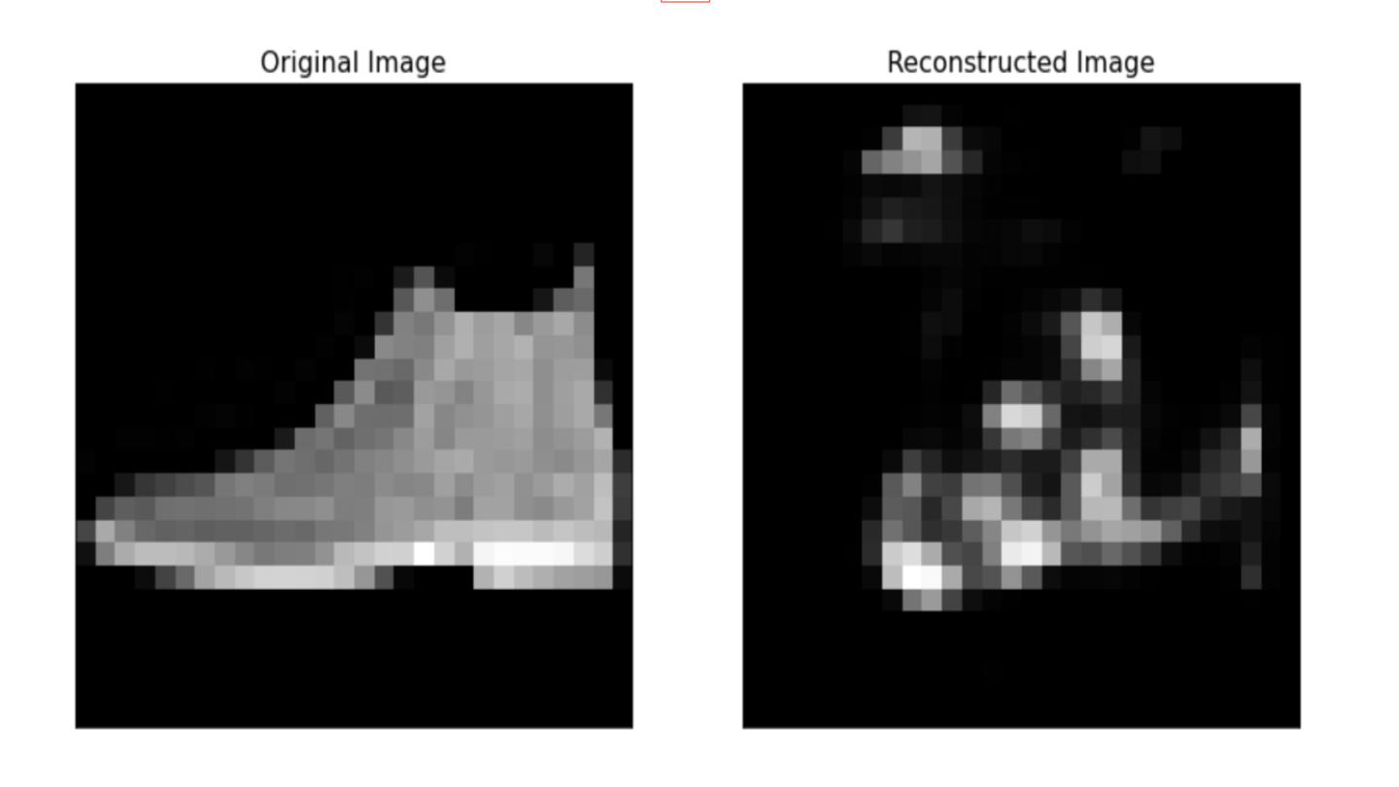
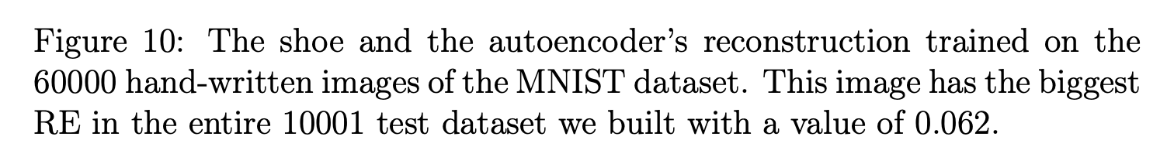
Anomaly Detection – A shoe…
Michelucci, Umberto. "An Introduction to Autoencoders." arXiv preprint arXiv:2201.03898 (2022).

Slide 21
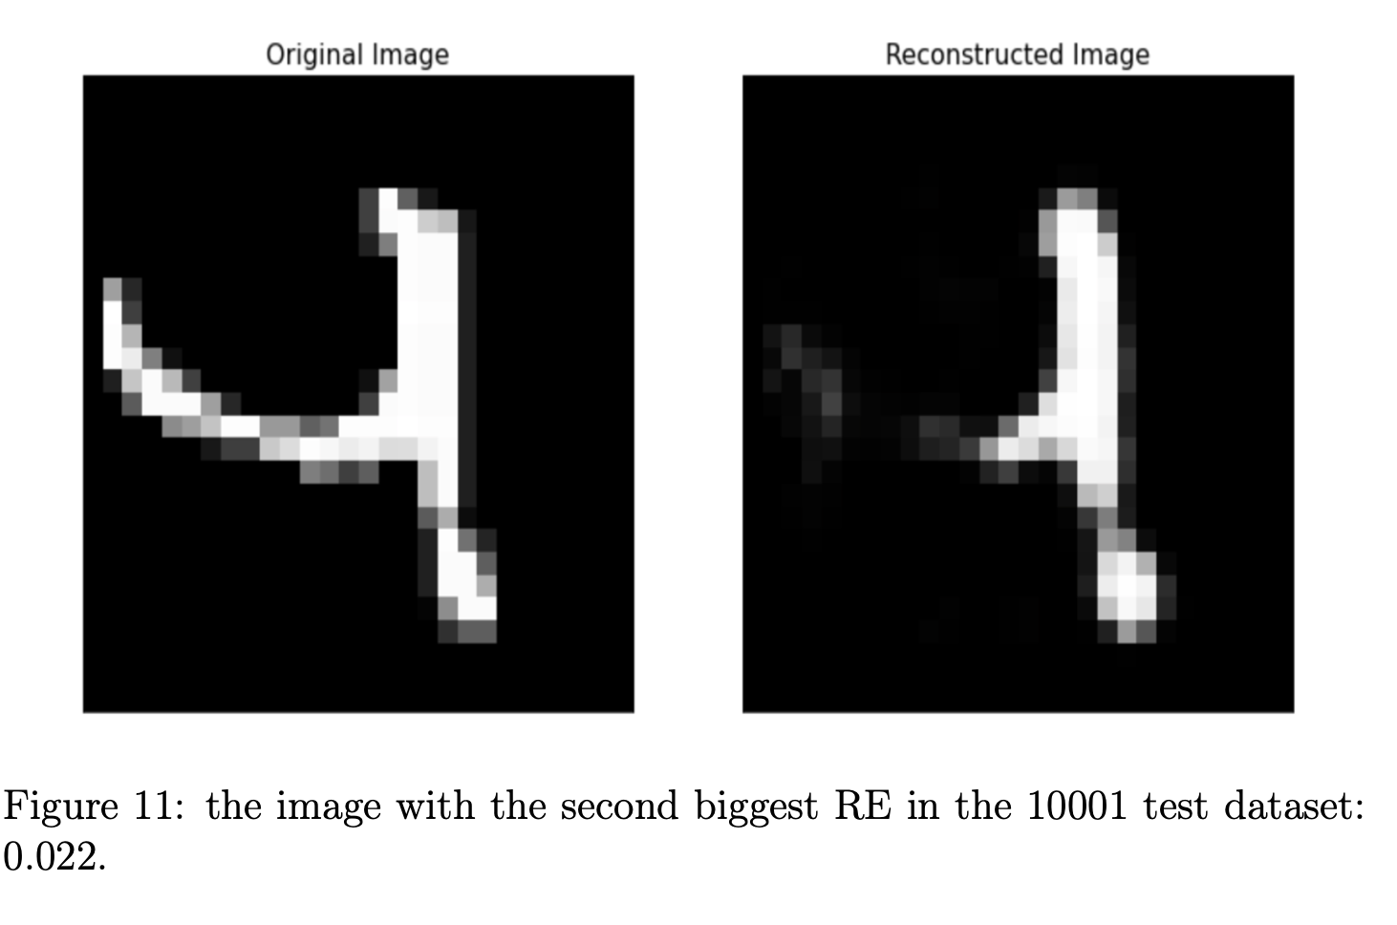
Anomaly detection – second larger RE
Michelucci, Umberto. "An Introduction to Autoencoders." arXiv preprint arXiv:2201.03898 (2022).

Slide 22
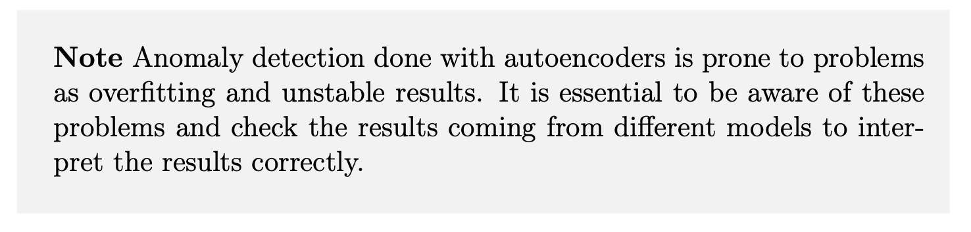
Small warning…
Michelucci, Umberto. "An Introduction to Autoencoders." arXiv preprint arXiv:2201.03898 (2022).

Slide 23
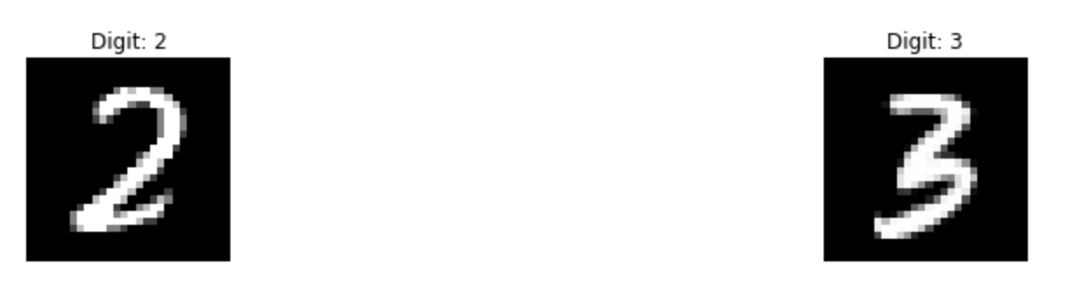
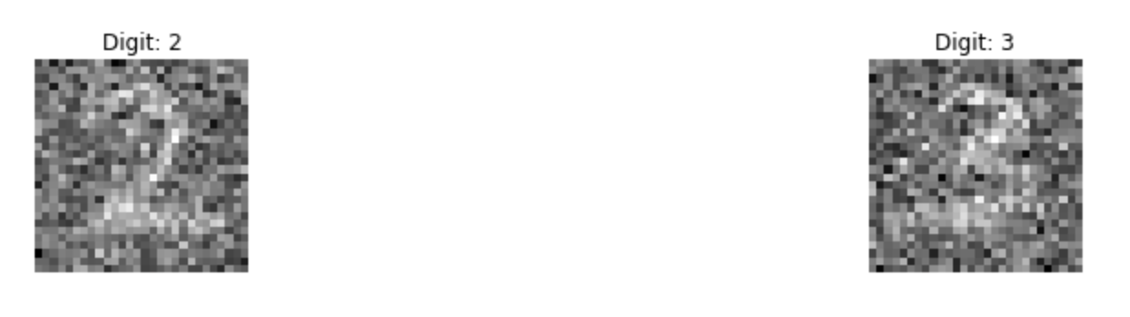
Denoising Autoencoders
noise = np.random.normal(0, 1, pure.shape)

Slide 24
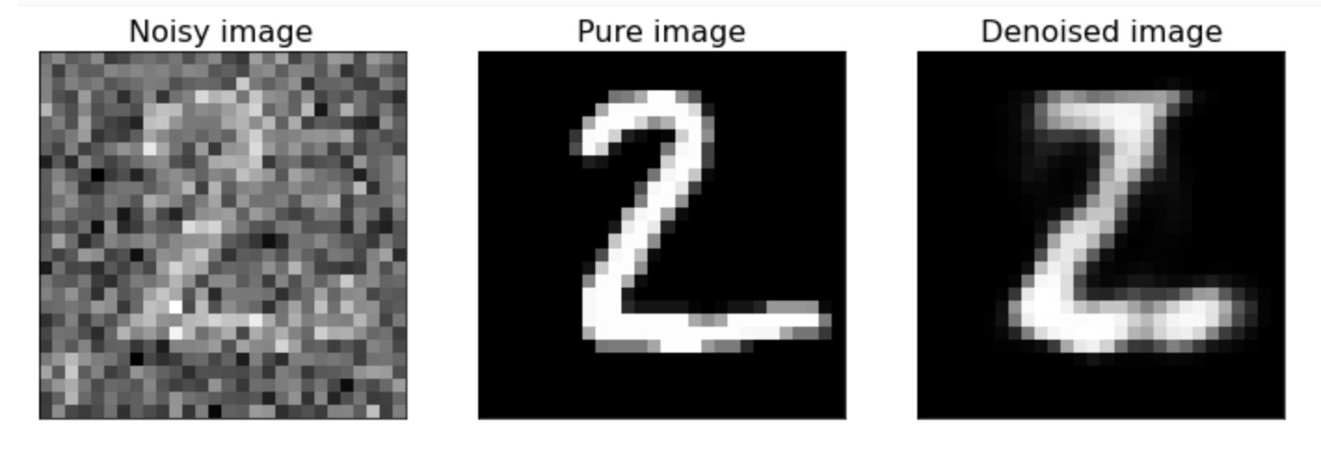
Denoising autoencoders (FFA) (784,32,784)
http://adl.toelt.ai/Autoencoders/Denoising_autoencoders_with_FFNN.html

Slide 25
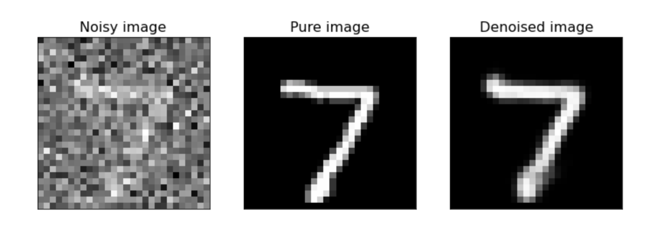
Denoising autoencoders (CNN) (784,32,784)
http://adl.toelt.ai/Autoencoders/Denoising_autoencoders_with_CNN.html

